Slide 1
POLST Community Presentation
Physician
Orders for
Life
Sustaining
Treatment
Notes:
PRESENTATION UPDATED February 2018: This presentation uses the April 1, 2017, CA POLST form.
POLST is an acronym that stands for Physician Orders for Life-Sustaining Treatment. POLST is a medical order that gives patients more control over their care during serious illness by specifying the types of medical treatment they want to receive.
POLST:
encourages communication between healthcare providers and patients.
enables patients to make more informed decisions.
clearly communicates these decisions to healthcare providers.
As a result, POLST can:
prevent unwanted or medically ineffective treatment.
reduce patient and family suffering.
help ensure that patient wishes are honored.
Use of the form began in California in 2008, and became part of state law on January 1, 2009.
[INSTRUCTORS: This slide presentation has been developed for your use. Materials are copyrighted by the Coalition for Compassionate Care of California. Please adapt to meet your needs and tailor to your audience and time allotted for presentation. If you have any questions, contact POLST Program Director with the Coalition for Compassionate Care of California at (916) 489-2222 or info@caPOLST.org.

Slide 2
POLST
What is POLST and why is it important?
Overview of the POLST form.
How do I complete a POLST?
Notes:
In this presentation, we will cover the following topics:
What is POLST and why is it important?
A brief overview of the POLST form.
How do I complete a POLST?

Slide 3
Why POLST?
Patient wishes often are not known.
The Advance Health Care Directive (AHCD) may not be accessible.
Wishes may not be clearly defined in AHCD.
The AHCD is not a medical order.
Allows healthcare professionals to know and honor your wishes for care.
Notes:
So why do we need POLST in California?
Studies have shown that patient wishes about care are often not known.
Even when a patient has an Advance Health Care Directive, it may not be accessible when needed.
Also, advance directives are not always clearly defined and are not a physician order.
The POLST form is clear about wishes and easy to access and read. Plus, it is an actionable medical order that healthcare providers can follow.
The POLST form allows healthcare providers to know patient wishes in the event of a serious illness, and to honor them.

Slide 4
POLST Conversations
Focus is on the conversation.
It is important to talk about and document your wishes before you become seriously ill.
Notes:
If you become very sick quickly, you may not be able to talk with your family or your doctor.
POLST facilitates discussion of possible medical situations, so that if something happened, your medical team and your family know your thoughts on what type of medical care you would want to receive.
It’s so important to have these discussions before something happens. People often think, “I’ll discuss this when I’m sick.” Unfortunately, that is often too late. You don’t want to wait until you are too sick to make decisions or until dementia causes forgetfulness.
Encourage participants to talk to their family and to their doctor.

Slide 5
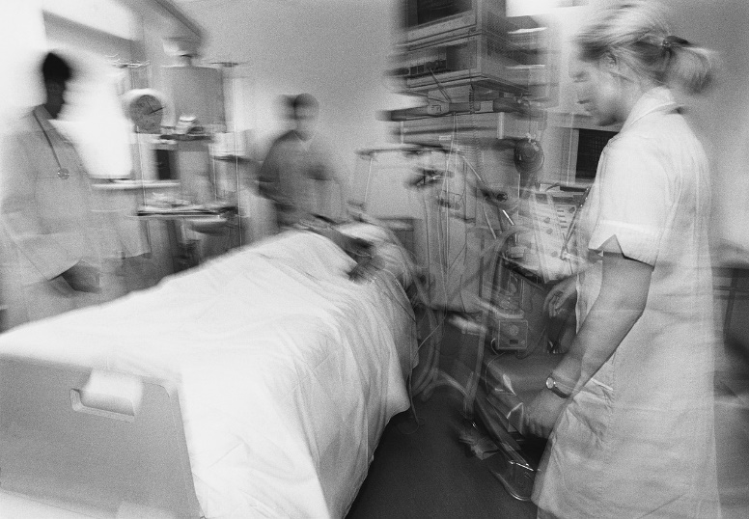
Patient Story: What We Know
Notes:
Let’s take a look at a typical story.
Mr. Jones is an 83-year-old man with severe congestive heart failure (CHF).
He is living in a skilled nursing facility (SNF) after being in the hospital with pneumonia.
He developed increasing shortness of breath and could not clearly talk to staff.
The SNF staff called 911 so he could be taken to the hospital.
The emergency department doctor couldn’t find any information in the paperwork sent by the nursing facility about what Mr. Jones would want done if his heart stopped beating and he was not breathing – in other words, if he died a natural death.
Since there was no information and Mr. Jones could not talk, the doctor wrote “Attempt Cardiopulmonary Resuscitation (CPR).”
Mr. Jones became very weak and had to have a breathing tube put down his throat and into his lungs to help him breath. He was on a ventilator machine that helped force air into his lungs.
He was transferred to the intensive care unit.

Slide 6
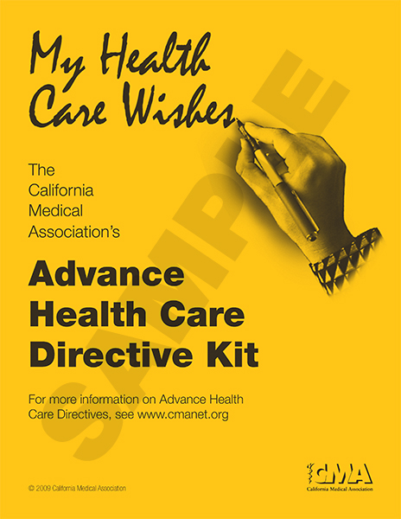
Patient Story: What We Didn’t Know
©California Medical Association 2000-2009
Notes:
Here’s what we didn’t know:
Mr. Jones had an Advance Health Care Directive.
It wasn’t with the paper work that was sent to the hospital.
It was at his home. He had been asked about it on admission, but his family hadn’t brought it in to add to his SNF medical record.
Mr. Jones had talked with his family and the SNF staff about his desire not to go back to the hospital and that he didn’t want to receive any aggressive treatment, including being put on a ventilator again.
There was documentation of this in the nurses notes at the SNF, but not in any documentation that was sent to the hospital.
The weekend nurses at the SNF could not reach Mr. Jones’ family and did not know about his wishes.
[NOTE re: AHCD Kit image: © California Medical Association 2000-2009. Published with permission of and by arrangement with the California Medical Association. More information regarding Advance Health Care Directives and related issues can be found in CMA’s California Physician’s Legal Handbook, which contains legal information on a variety of subjects of everyday importance to practicing physicians. CMA’s Advance Health Care Directive Kit and California Physician’s Legal Handbook may be obtained from CMA Publications at (800) 882-1262 or CMA’s online bookstore at www.cmanet.org.]

Slide 7
Patient Story: What Happened
AHCD not transferred with patient
DNR wishes not documented
Over-treatment against patient wishes
Unnecessary pain and suffering
Notes:
So what happened in our story?
The Advance Health Care Directive was not transferred with Mr. Jones. The SNF didn’t have it, so they couldn’t transfer it.
Mr. Jones’ “Do Not Resuscitate” wishes were not documented in a way that was easily found by staff. When he was transferred from the hospital to the SNF, there were no orders stating that he did not want to be on a ventilator machine.
Mr. Jones received over treatment which went against his wishes.
Because of this he experienced unnecessary pain and suffering.
[REFERENCE: Patient story adapted from Lynn, Joanne; Goldstein, Nathan. Advance Care Planning for Fatal Chronic Illness: Avoiding Commonplace Errors and Unwarranted Suffering. Annals of Internal Medicine, Vol. 138, Issue 10, May 20, 2003, pages 812-818.]

Slide 8
What is POLST?
A medical order recognized throughout the medical system
Portable document that transfers with the patient
Brightly colored, standardized form for entire state of California
Notes:
So, what is POLST? [INSTRUCTORS: Pull out your POLST form to show]
It is a medical order that is recognized throughout the medical system.
It is a portable document that transfers with the patient from one care setting to another.
It is easily distinguished by its bright pink color.
It is a standardized form for the whole state.

Slide 9
What is POLST?
Allows individuals to choose medical treatments they want to receive and identify those they do not want
Provides direction for healthcare providers during serious illness
Notes:
POLST provides direction for a range of medical treatments so that healthcare professionals can provide the treatments patients do want and avoid those that they do not want.

Slide 10
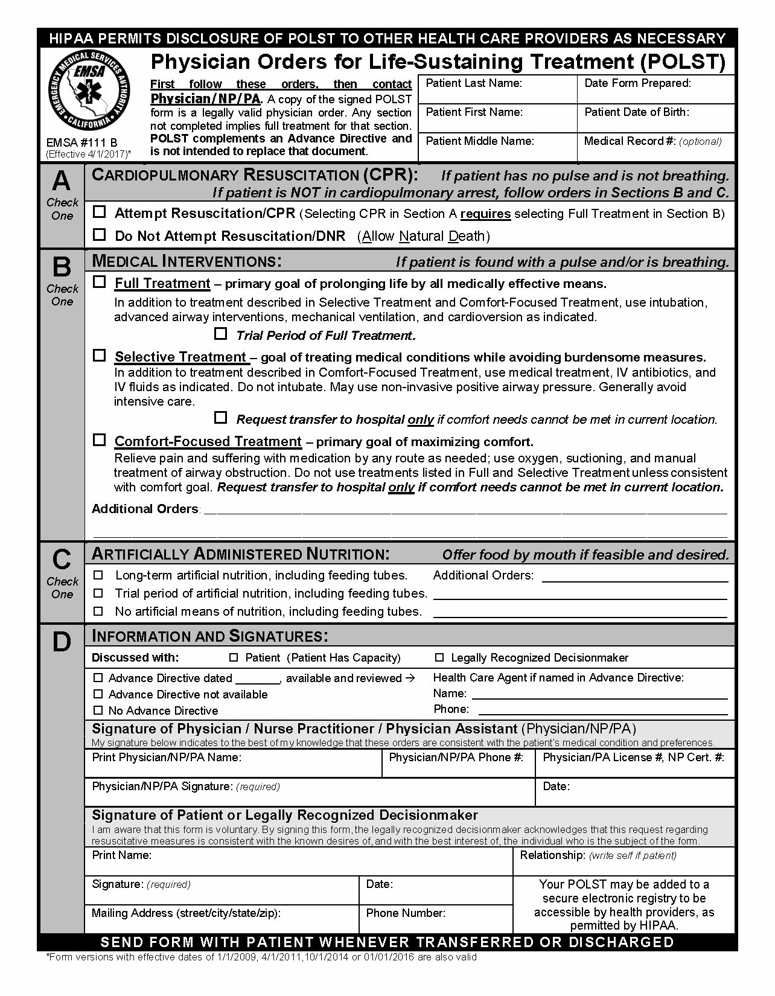
Notes:
This is what the front of the POLST form looks like.
We will talk about the POLST form in more detail in a few minutes.
It is important for you to talk with your doctor or other member of your healthcare team about POLST and your medical conditions.
[INSTRUCTORS: When you handout POLST forms, be sure to clearly encourage class participants to NOT complete their POLST form until they have a conversation with their doctor or healthcare provider who knows their health conditions.]
You can also handout AHCDs and POLST Consumer Brochures.

Slide 11
Who Would Benefit from Having a POLST Form?
Chronic, progressive illness
Serious health condition
Medically frail
Notes:
Who would benefit from having a POLST form?
POLST is designed for people who:
Have a chronic, progressive illness that cannot be cured,
Have a serious health condition, or
Are medically frail.
Anyone can have a POLST, if the patient and the doctor agree it would be a good idea.
There are no age specifications. POLST can be used with both adults and children.

Slide 12
POLST History
POLST development began in Oregon in 1991
Expanded to most of the United States
Studies have shown that POLST is effective in providing care that is consistent with patient wishes
Notes:
California’s POLST program is part of a larger movement across the country.
POLST has been used in Oregon since 1991.
It was developed initially for SNF patients who were often transferred back and forth between the hospital, SNF or their home.
More than one million forms have been distributed in Oregon.
The use of the POLST form has expanded to most of the US – we’ll take a look at a map in a moment.
There have been several studies showing how well POLST works in allowing providers to honor patient wishes.

Slide 13
National POLST Paradigm Programs
www.polst.org
*As of June 2018
Mature Programs (2)
Endorsed Programs (22)
Developing Programs (24)
No Program/Contacts (1)
Programs That Do Not Conform to POLST Requirements (4)
Notes:
Here is a map of POLST programs across the US.
The white states do not have formal POLST programs.
Information about the National POLST Paradigm program can be found at www.polst.org.

Slide 14
POLST Success
Oregon Study: Location of Death and POLST Orders
58,000 deaths reviewed, 31% had POLST in Oregon Registry
Patient treatment choices honored, including avoiding dying in hospital
Fromme EK, JAGS 2014
Notes:
There have been several studies showing how well POLST works in allowing providers to honor patient wishes.
A recent Oregon study looked at the relationship between POLST treatment choices and the care setting (home, hospital or SNF/Assisted Living) at the time of death. Of the 58,000 deaths reviewed, 17,902 (31%) had a POLST form in the Oregon POLST Registry.
In-hospital death for patients with Comfort Measures Only was 6.4%.
For patients requesting Full Treatment 44.2% died in hospital, and for Limited Interventions 22.4% died in hospital.
For those with no POLST form in the registry, 34.2% died in the hospital.
The study found those who died with POLST Comfort Measures Only orders were significantly less likely to die in the hospital, compared to those requesting Full Treatment.
Full Treatment patients were almost 10 times as likely to die in the hospital than Comfort Measures Only patients.
Limited Interventions patients were 4 times as likely to die in the hospital than Comfort Measures Only patients.
[REFERENCE: Fromme, E. K., Zive, D., Schmidt, T. A., Cook, J. N. B. and Tolle, S. W. (2014), Association Between Physician Orders for Life-Sustaining Treatment for Scope of Treatment and In-Hospital Death in Oregon. Journal of the American Geriatrics Society. doi: 10.1111/jgs.12889]
[INSTRUCTORS: The California POLST form used the terms “Limited Additional Interventions” and “Comfort Measures Only” in the 2009 and 2011 versions. The October 2014 POLST version uses the terms “Selective Treatment” and “Comfort-Focused Treatment.”]

Slide 15
POLST in California
The Coalition for Compassionate Care of California (CCCC) is lead agency
Support from California Health Care Foundation
Grassroots efforts of local POLST coalitions and communities
Notes:
Let’s take a look at what is happening with POLST in California.
The Coalition for Compassionate Care of California is the lead agency for POLST in California, and is focused on implementing POLST as a community standard of practice.
With support from the California Health Care Foundation, CCCC is working with more than 30 local POLST coalitions throughout the state to implement POLST.
This grassroots approach to POLST implementation is one of the hallmarks of the California POLST program.

Slide 16
POLST in California
Assembly Bill 3000
Original POLST legislation
Effective January 1, 2009
Assembly Bill 637
Authorizes NPs and PAs to sign POLST
Effective January 1, 2016
Notes:
POLST went through the legislative process as California Assembly Bill 3000.
It was championed by Senator Lois Wolk of Yolo County and was supported fully by our legislators around the state – it passed unopposed.
It was signed by Governor Schwarzenegger in August of 2008 and became law in California effective January 1, 2009.
Another important piece of POLST legislation, Assembly Bill 637, was passed in 2015 and became effective January 1, 2016. This bill authorizes nurse practitioners and physician assistants, acting under the supervision of a physician and within their scope of practice, to sign POLST forms.

Slide 17
POLST in California
One form for entire state
Use not mandated
Honoring form is mandated
AB 3000, Wolk. Part 4, Sec 7, Probate Code Section 4782
Notes:
Some of the key points in the bill to be aware of:
There is one form for the entire state. This is an important requirement for POLST to work.
POLST is a voluntary form. It is not mandatory for anyone to use the form, but honoring the form is mandatory! Healthcare providers must recognize the POLST form and honor the patient’s wishes.
Must follow POLST wishes except if contrary to generally accepted healthcare standards or medically ineffective treatment.
This means that if someone is critically ill and treatments requested on the POLST either will not help the patient or can cause more harm or suffering, the doctor will discuss the appropriate plan of care with the patient and/or family.
When traveling in California, “Would any hospital honor a properly executed POLST form? The answer is, “Yes.” If traveling outside of California, the POLST may be recognized if the particular state is using POLST. In every state, the POLST will be valuable as a statement of preferences describing someone’s wishes for medical care.

Slide 18
POLST vs. Advance Health Care Directive
POLST complements the Advance Health Care Directive (AHCD).
POLST is not intended to replace the AHCD.
Both are legal documents.
AB 3000, Part 4, Sec 3, Probate Code 4780 (3) (c)
Notes:
Does POLST replace the advance directive? Absolutely not!
POLST aims to turn the values and wishes expressed in a person’s AHCD into medical orders that can be easily understood and followed by healthcare providers, including Emergency Medical Services (EMS).
In California, the term Advance Health Care Directive includes both the Durable Power of Attorney for Healthcare and the Living Will.
[REFERENCE: AB 3000, Part 4, Section 3, Probate Code Section 4780 (3) (c) “The healthcare provider, during the process of completing the POLST form, should inform the patient about the difference between an Advance Health Care Directive and the POLST form.”]

Slide 19
POLST vs. Advance Health Care Directive
POLST | AHCD
For seriously ill/frail, at any age Medical orders for medical treatment Can be signed by decision-maker | For anyone 18 and older General instructions for treatment Appoints decision-maker
Notes:
POLST is designed for people who have:
Have a chronic progressive illness,
Have a serious health condition, or
Are medically frail.
POLST:
Someone not fitting into one of those categories may have POLST form if that person and their physician agree that it would be a good idea to have one.
Is a medical order that documents wishes for treatment at this point in time; provides guidance to emergency medical personnel; usually completed in a medical setting.
POLST is signed by both you and the physician/NP/PA caring for you.
There is one standard form for California.
Advance Health Care Directive:
We encourage everyone 18 years and older to have an AHCD.
An AHCD is a legal document completed in advance that allows you to:
make general statements about your healthcare wishes, and
appoint a healthcare decision-maker to speak on your behalf if you are unable to speak for yourself. Only you can complete an AHCD and name your decision-maker(s).
There are multiple AHCD forms available.
POLST can be completed and signed by the patient’s decision-maker, if the doctor states that you are not capable of making your own decisions. The decision-maker must talk with the doctor/NP/PA about the POLST choices. POLST is then signed by both the doctor/NP/PA and the decision-maker.
You can change your POLST form and AHCD at any time if your wishes or medical condition changes. It is good to review your forms every few years or if your situation changes.

Slide 20
Where Does POLST Fit In?
Advance Care Planning Continuum
Age 18
Complete an Advance Directive
C
O
N
V
E
R
S
A
T
I
O
N
S
Update Advance Directive Periodically
Diagnosed with Serious or Chronic, Progressive Illness (at any age)
Complete a POLST Form
Treatment Wishes Honored
Notes:
It’s important to think about our wishes for medical treatment before a health crisis.
This slide shows where POLST fits into the Advance Care Planning Continuum.
Starts at age 18 with completing an AHCD
Your AHCD should be updated periodically – check names, contact information and healthcare wishes
If you are diagnosed with a serious or chronic, progressive illness at any age, talk with your doctor about completing a POLST form
The goal is that your treatment wishes are honored
What is the word along the left side?
An ongoing conversation over the years with your healthcare decision-maker, family and healthcare provider is very important.

Slide 21
POLST vs. Pre-Hospital DNR (Do Not Resuscitate)
Similarities:
Medical orders
Address Do Not Resuscitate
Intended for medically frail or those with chronic or serious illness
Notes:
Let’s take a look at the similarities and differences between the POLST and the Pre-Hospital DNR.
Both forms are medical orders.
Both address Do Not Resuscitate if you are not breathing and your heart is not beating.
Both are for the medically frail or those with chronic or serious illness.

Slide 22
POLST vs. Pre-Hospital DNR (Do Not Resuscitate)
POLST | Pre-Hospital DNR
Allows for choosing resuscitation Allows for other medical treatments Honored across all healthcare settings | Can only use if choosing DNR Only applies to resuscitation Only honored outside the hospital
Notes:
There are differences between the two forms, however.
POLST:
Allows for choosing CPR in addition to saying no to it.
Allows for decisions about other medical treatments, such as artificial nutrition and treatment during serious illness.
Is honored across all healthcare settings (in the SNF, clinics, hospitals, home, EMS System, etc.) - the Pre-Hospital DNR is a medical order that is honored outside of the hospital only (home, assisted living, SNF, EMS System).
POLST is more comprehensive than the DNR form.

Slide 23
Notes:
Here is the front of the POLST form.
There are 4 main sections:
Section A addresses: Attempt Resuscitation/CPR or Do Not Attempt Resuscitation/DNR - if the person has no pulse and is not breathing – they have died a natural death.
Section B addresses: Medical Interventions - if the person has a pulse and/or is breathing, the three choices address how aggressive you want your medical care to be if you are seriously ill. The options are for:
Full Treatment with the primary goal of prolonging life by all medically effective means, or
Selective Treatment, with the goal of treating medical conditions while avoiding burdensome measures, or
Comfort-Focused Treatment with the primary goal of maximizing comfort.
Section C addresses: Artificially Administered Nutrition, including feeding tubes
Section D includes documentation regarding your AHCD and your signature (or your decision-maker’s signature if you are not capable of signing the form), as well as the signature of the doctorNP/PA caring for you.
It is important to have a full conversation with your doctor or other member of your healthcare team to fully discuss the POLST treatment options.

Slide 24
How Do I Complete a POLST?
Talk to your doctor/NP/PA about what kind of medical treatment you would want if you became seriously ill.
Talk to your doctor/NP/PA about POLST.
Talk to your family about your decisions.
Notes:
It is important to talk to your doctor/NP/PA at any time about the types of treatments you would want to receive if you became seriously ill, such as if you had a heart attack and your heart stopped beating or if you became very ill with a pneumonia, like Mr. Jones.
You can ask your doctor/NP/PA about completing a POLST form.
Ask for a brochure explaining POLST (from your doctor or the nursing staff at the hospital or skilled nursing facility).
It is also very important to talk with your family and explain your wishes for your medical care. Talking with your family is actually giving them a gift – they understand and can support your decisions.
It is helpful to tell your family how you feel and what you value, what is important to you. For example, what do you hope to be able to enjoy for the rest of your life, or what do you like to do every day.
Family members may not understand how it feels to be sick, tired, weak or unable to do the things you used to enjoy doing.
Tell your family what types of medical treatment you are willing to accept and what medical treatments you would not want.
Talking with them helps your family know what your wishes are so they can follow them. They are relieved of the burden of making decisions for you or questioning whether they made the “right” decision.
Talking helps your family support you and each other during serious illness.

Slide 25
Where Do I Keep a POLST?
Original pink POLST stays with you!
At home:
Post in easy-to-find location (with AHCD)
Give to Emergency Medical Services
At Hospital or Skilled Nursing Home:
File in medical chart (with AHCD)
Goes with you if you are transferred
Notes:
The bright pink POLST form stays with you at all times.
In your home, keep the POLST in an easy-to-find location – for example, on the refrigerator or hanging on a wall by your bed or with your medications.
Your family should give Emergency Medical Services staff your POLST form when they arrive. The POLST will go with you if you travel by ambulance.
If you are in a hospital or SNF, the POLST will be kept in your medical chart.
It is helpful to keep the POLST, along with your AHCD, in a plastic sleeve.
[INSTRUCTORS: It is helpful to have a POLST form and an AHCD in a plastic sleeve to show your audience.]
A DNR medallion or bracelet may be purchased with either a signed Pre-Hospital DNR form or POLST form. One resource is the California Emergency Medical Services Authority for more information on medallions. See #4 under EMSA FAQs at emsa.ca.gov/Forms.

Slide 26
Can POLST be Changed?
You can change your POLST at any time.
If you cannot speak for yourself, your healthcare decision-maker may request a change based on a change in your condition or new information about your wishes.
Notes:
Can POLST be changed? Yes – you can change your POLST at any time. POLST is a voluntary form. You can decide to discard or change your POLST at any time.
Talk with your doctor/NP/PA if you would like to change your POLST form.
If you cannot speak for yourself, your legally recognized healthcare decision-maker may request to change the orders, in collaboration with the physician/NP/PA based on your known wishes or, if unknown, your best interests. A change to the POLST form must be in discussion with the doctor/NP/PA, based on a change in your condition or new information about your wishes.
If you change your POLST form, write “VOID” with a line across the front of the form, and sign and date along this line. If someone has more than one POLST form, the form with the most recent date is followed.

Slide 27
POLST
Talk with your doctor/NP/PA and your family
Visit www.caPOLST.org
Notes:
Take the time to talk with your medical team and your family about your wishes for medical care.
POLST is not just “a pink piece of paper” or a “check box form.” The meaningful conversations you have with your doctor/NP/PA and family can help them know and honor your wishes.
More information about POLST is available from the Coalition for Compassionate Care of California at www.caPOLST.org.

Slide 28
Questions?
Notes:
What questions do you have?
INSTRUCTORS:
Feel free to add your contact information to the slide. For more information/assistance answering questions, contact the POLST Program Manager at (916) 489-2222 or info@caPOLST.org, or visit www.caPOLST.org.

